Slide 1
Connections with Partial
Differential Equations
Chapter 6
陳博宇

Slide 2
*purpose*
There are two ways to compute a derivative
security price
(1) Use Monte Carlo simulation and risk-
neutral measure
(2)Numercially solve a partial differential
equation

Slide 3
6.2 Stochastic Differential Equations
The gist of the paragraph:
Introducing three example to describe a stochastic differential equation.
(1)Geometric Brownian motion
(2)Hull-White interest rate model
(3)Cox-Ingersoll-Ross interest rate model

Slide 4




A stochastic differential equation
(6.2.1)
An initial condition : where
Here and are given functions, called the drift and diffusion , respectively
How could we find a stochastic process which have some special characteristics?

Slide 5

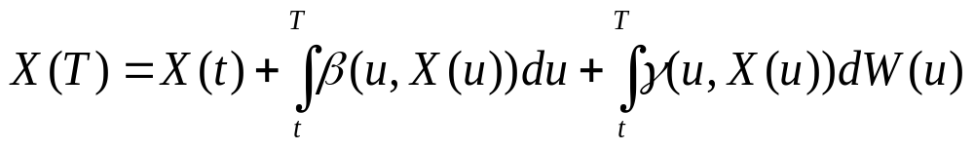
Special Characteristic
(6.2.2)
(6.2.3)
But this process can be difficult to determine explicitly because it appears on both the left- and right-hand sides of equation (6.2.3).

Slide 6
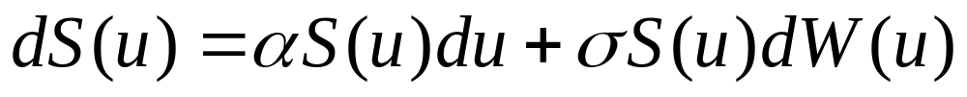
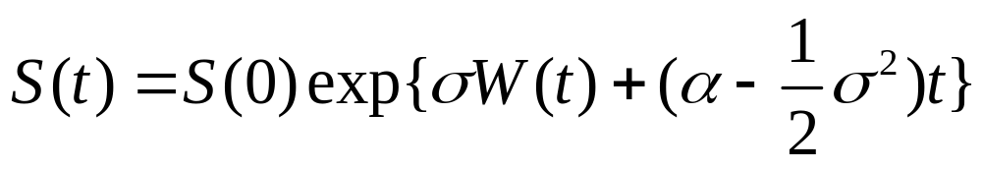

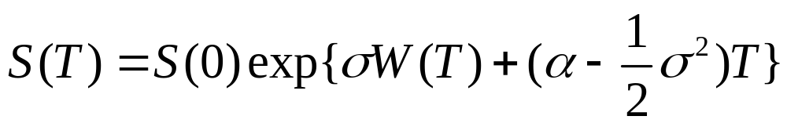
Geometric Brownian motion
In the initial time t=0;

Slide 7
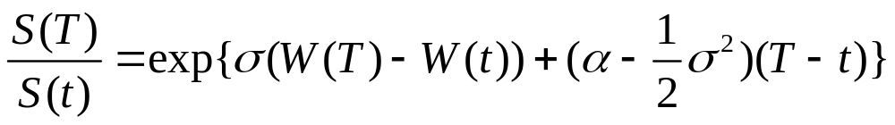
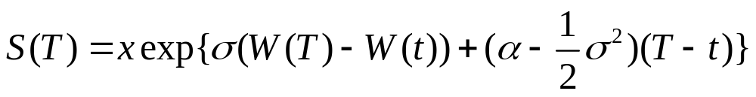
Geometric Brownian motion
Dividing S(T) by S(t)
The initial condition S(t)=x
Hence, S(T) only depends on the path of the Brownian motion between t and T.

Slide 8
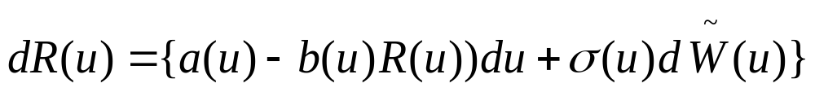

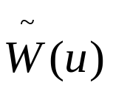
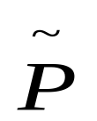
Hull-White interest rate model
Where a(u),b(u), and are nonrandom positive function of the time variable u.
is a Brownian motion under a risk-neutral measure

Slide 9
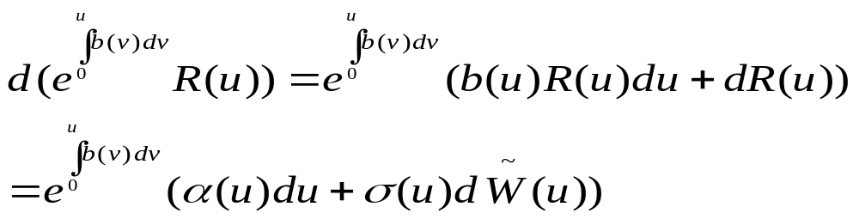
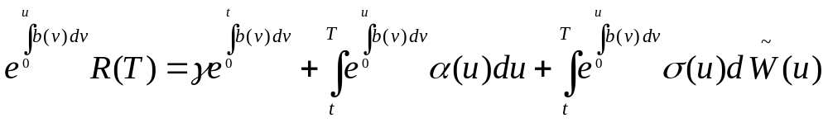
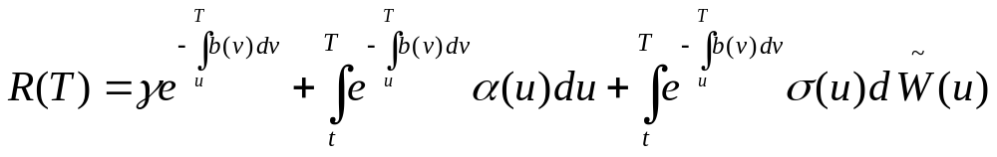
Hull-White interest rate model

Slide 10
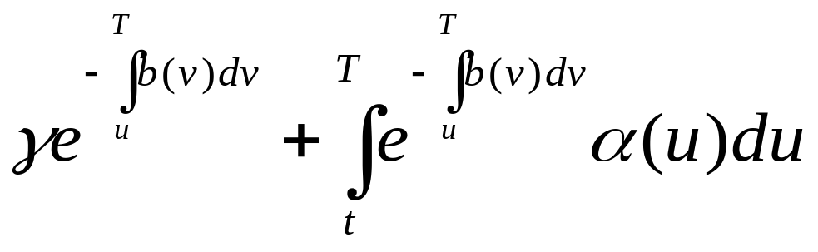
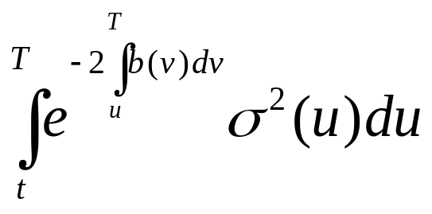
Recall
From Theorem 4.4.9 (P149) we could know
R(T)is normally distributed with mean
and variance

Slide 11
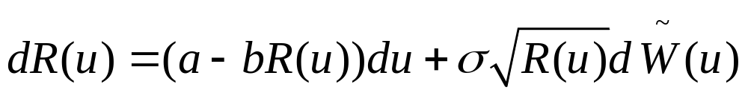

Cox-Ingersoll-Ross interest rate model
where a ,b, and are positive constant .
There is no formula for R(T), but we could
use the Monte Carlo simulation to solve the
problem.

Slide 12
6.3The Markov Property
*purpose*
因為對X(T)此隨機過程我們可能並沒有足夠的訊息去描述它，如果可以用具有良好性質的數值方法去模擬此過程，或許我們可以更了解它的結構與特色。

Slide 13
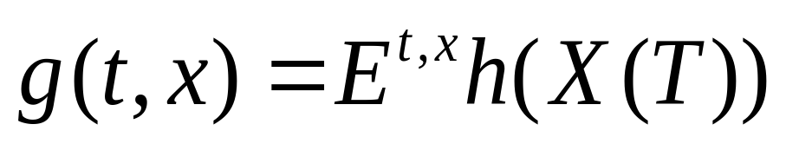
Borel-measurable function
h(y) is a borel-measurable function
X(T) is the solution to (6.2.1) with initial condition.
One way to simulate is the Euler method.

Slide 14

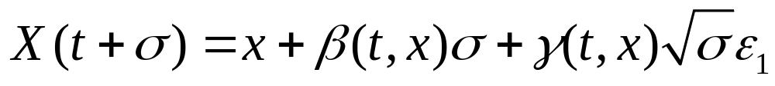
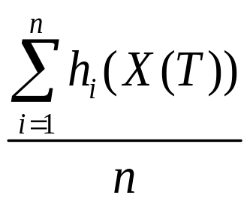
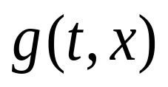
Euler method
Choose a small positive step size , and
approximate

Slide 15


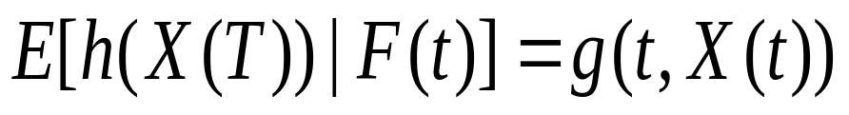
Theorem 6.3.1
Let X(u), be a solution to the stochastic
Differential equation (6,2,1) with initial
condition given at time 0. Then for
Definition 2.3.6(P74)

